Slide 1
Recursions and Dynamic Programming
Il-Chul Moon Dept. of Industrial and Systems Engineering KAIST
icmoon@kaist.ac.kr
Notes:
Today, we’ll explore recursion and dynamic programming.

Slide 2
Weekly Objectives
This week, we learn how to program recursive routines and dynamic programming concepts
Recursion
Dynamic programming
Objectives are
Understanding the concept of recursions
Repeating problems
Divide and conquer
Recursion function call
Recursion escape
Recursion depth
Able to implement recursive programs
Understanding the concept of dynamic programming
Reusing previous function call result
Memoization for time saving
Notes:
This is what we’ll learn this week.
You have to understand what is recursion and dynamic programming.
Recursion is not a difficult concept, but it is new.
That’s why we need to fully understand it.
A Recursion is a function that calls itself within a function.
In Korean, it is a recursive call, which means that it’s going back to itself.
Recursion can be explained through an example of repeating problems. The concept of “divide and conquer” is actually quite similar.
Anyway, this is necessary to understand and implement a recursion.
Finally, dynamic programming is a concept that reuses various outcomes of function calls from recursions.
It serves to expedite the runtime.
Now, we’re going to cover recursion and dynamic programming.

Slide 3
Recursion
Notes:
First, we will explore what recursion is.

Slide 4


Repeating Problems and Divide and Conquer
Calculating a budget of a company?
Departments consist of the company
Departments within departments
Can’t avoid the below structures
class Department
dept = [sales, manu, randd]
def calculateBudget(self)
Sum = 0
For itr in range(0, numDepartments)
Sum = sum + dept[itr].calculateBudget()
Return sum
Budget
600M won
Company A
Budget
100M won
Budget
300M won
Budget
200M won
Sales Dept.
Manufacturing Dept.
R&D Dept.
Russian Doll:
Dolls within dolls
Budget
10M won
Seoul Sales Branch
Busan Sales Branch
Daejeon Sales Branch
Notes:
Before defining recursion, we first need to understand what a repeating problem is. We need to understand how to “divide and conquer.”
Let’s say you’re a CEO managing a company.
If you need KRW 6 million as the total budget of the firm, there are divisions that spend parts of this budget.
You are told what each division requires: KRW 1 million for the Sales Division, KRW 3 million for production, and KRW 2 million for the R&D Division.
So when you add all of that up, the total budget is set to KRW 6 million.
In the Sales Division, the budget is further divided into: KRW 100,000 for the Seoul branch. Then, some will go to the Busan Branch, and some to the Daejeon branch.
You can see how such a large budget is broken down to different parts of a big overall hierarchy.
There is a close similarity between the respective budget breakdowns from the perspective of CEO and of the head of the Sales Division.
The only difference between the two is the amount of the total budgets.
A repeating problem, in essence, divides a large single problem, which is then defined into smaller repetitive problems.
One of the conditions is to divide a problem into smaller ones.
If you could understand the concept of a repeating problem, you can automatically understand “divide and conquer.”
The budget structure may be difficult to understand if we consider the CEO, sales, production, and R&D divisions as the one entity – a company.
And yet, how did we see that the company spends large portions of the budget in the production and R&D divisions, and a relatively small portion of it in the Sales Division?
We were able to see it because we were the ones who divided the budget.
In this manner, the process of solving a large problem by dividing it into smaller ones is called, “divide and conquer.”
Here’s another example of a repeating problem.
There is a class called a Department. Inside that, we have [sales, manu, randd] and a function to calculate the budget, calculateBudget. When the budget is computed it will use the calculateBudget function again to calculate the budget.
Therefore, the upper level budget is eventually the sum of all the budgets at the lower level. The budgets at the lower level will be added up to get the budget of the higher level.
The interesting point is that the function, calculateBudget, calls an identical function at the lower level.
This is an example of recursion. It calls an identical function for dividing smaller problems. This is the exact process of solving a repeating problem with computer programming. This very process can be referred to as “divide and conquer.”
This is a traditional Russian nesting doll.
This doll features a peculiar structure. It’s made up of dolls of decreasing size, and the smaller dolls are all placed inside the larger ones, one after another.
So, five dolls are stacked inside larger dolls until they become a single larger doll.
This is also another example of a repeating problem.
These dolls share an identical figure, repeating themselves at smaller sizes.
Thus, we can view it as a repeating problem.

Slide 5

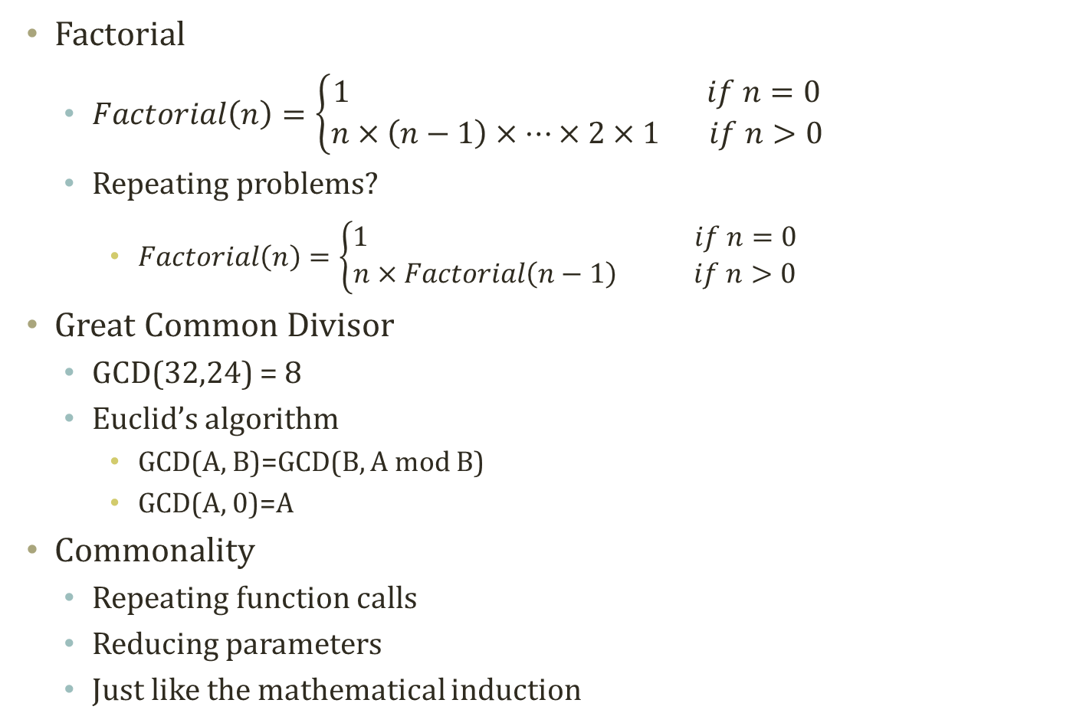
More examples…
Factorial
$Factorial\left(n\right)=\left\{\begin{aligned}1 if n=0 \\ n×\left(n−1\right)×…×2×1 if n>0\end{aligned}\right.$
Repeating problems?
$Factorial\left(n\right)=\left\{\begin{aligned}1 if n=0 \\ n×Factorial\left(n−1\right) if n>0\end{aligned}\right.$
Great Common Divisor
GCD(32,24) = 8
Euclid’s algorithm
GCD(A, B)=GCD(B, A mod B)
GCD(A, 0)=A
Commonality
Repeating function calls
Reducing parameters
Just like the mathematical induction
Self-Similar
Notes:
Let’s look at more diverse examples of repeating problems.
This is a factorial.
This factorial is calculated as 10! = 10 x 9 x 8 x ... x 1.
It also has the structure of a repeating problem.
A factorial can be defined like this.
The reason why it falls into the category of a repeating problem is because after separating n, what’s below becomes a factorial again.
It takes the same pattern: it’s a function within a function. The entry of the factorial function was n, which is replaced by n-1, and then it called the same function.
Another example is a great common divisor.
A great common divisor is the largest integer that can divide two numbers without any remainder.
The great common divisor of 32 and 24 is 8.
One way to get the answer is by using Euclid’s algorithm.
Let’s take the example of 32 and 24
To calculate GCD(32, 24), 24 will be left behind. The remainder of 32 divided by 24, and the result of calculation, will be: GCD(32, 24) = GCD(24, 8)
It is also repeated to fetch 8. 24 is divided by 8 to have a remainder of 0. This results in GCD(24, 8) = GCD(8, 0), thereby being identical with what is here.
And so, we can find the great common divisor: 8.
This also has the structure of a repeating problem.
The size has been reduced from 32, 24 and 24, 8 to 8, 0, while calling the same function, GCD.
In this way, we can be sure that Euclid’s algorithm is also a type of repeating problem.
What they share in common lies in the recursive function calls and decreasing parameters, characteristics that make the program use a familiar method for mathematical induction.
Here is an intriguing picture that illustrates recursion.
In the picture, you will notice a person who looks like a nun holding a box and some tea.
In the box, you will find the nun holding something again.
As this picture shows, a repeating problem can be explained in repetitive, self-copying images in smaller sizes in self-repeating pictures.

Slide 6
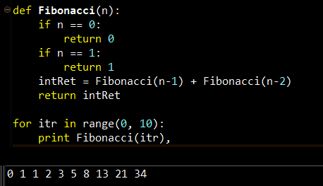
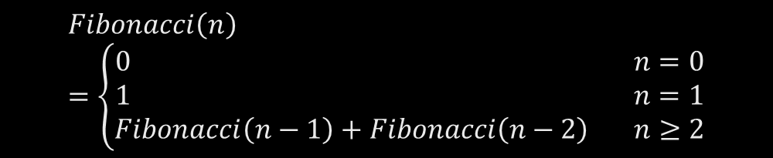
Recursion
A programming method to handle the repeating items in a self-similar way
Often in a form of
Calling a function within the function
def functionA(target)
….
functionA(target’)
….
if (escapeCondition)
Return A;
Program Execution Flow
F(4)
F(3)
F(2)
F(2)
F(1)
F(1)
F(1)
F(0)
F(0)
$$Fibonacci\left(n\right)=\left\{\begin{aligned}0 n=0 \\ 1 n=1 \\ Fibonacci\left(n−1\right)+Fibonacci\left(n−2\right) n≥2\end{aligned}\right.$$
Notes:
I guess that now you may have a clearer idea about what is a repeating problem or “divide and conquer.” Now, I’ll define what recursion is.
Recursion is a method of programming that handles repetitive items in a self-similar manner.
Let me show you an example.
If we are to express this in a single cardinal sentence, a function calls itself one or more times in its body.
Let’s look at the definition.
Although it may look like programming language, this is actually pseudo code. This code isn’t actually operable. It’s more like a sort of simple guide that you can refer to for programming.
Here, we are defining functionA.
However, when we need to call functionA inside functionA, we use a prime symbol (‘) attached to a parameter.
The difference between target and target’ lies in their sizes.
In addition, we need an escape routine.
A recursion will return if it meets a specific escapeCondition.
Let’s see how it is implemented in actual Python code.
We are making a function with “def”.
We also have Fibonacci(n).
The Fibonacci sequence signifies a series of consecutive numbers.
0 and 1 are given to the consecutive numbers. The sum of the two will be 1 as 0 is added to 1. The result was then added to the next number, resulting in 0 1 1 2 3 5 8... This is called the Fibonacci sequence.
So, this function calculates the Fibonacci sequence.
It is a rule that the two numbers in front are set as 0 and 1.
Therefore, only the front numbers need to follow the rule.
Now, the rule below merits our attention. A new number is obtained by adding the preceding two numbers, or intRet = Fibonacci(n-1) + Fibonacci(n-2).
To do so, the parameters of the Fibonacci are reduced from n to n-1 or n-2, thereby calling the Fibonacci function once again.
It will end up calling the same function twice within the specified function.
This process will call the same function, which is called after becoming a parameter of a smaller number.
What you see here is the escape routine.
When n is 0 or 1, it will not recur itself anymore. It will escape from the routine.
When we call this function F, what would happen if we call F(4)?
At the moment when F(4) is called, 4 will be inserted as the parameter. Since it is neither 0 nor 1, it will skip the escape routine to call F(4 -1) = F(3).
At the moment when F(3) is called, it will once again jump the escape routine to call F(3 – 1) = F(2).
F(4 - 2) = F(2) has not yet been executed in F(4).
When F(2) is called, it will skip the escape routine to call F(1). F(1) will no longer call the recursion due to the escape routine. Instead, it will print out 1 and ascend to F(1).
We’ve obtained 1 as the return value of F(1) in F(2) and also called F(2 – 2) = F(0). It won’t go through any recursion to return 0 via the escape routine.
Thus, it will be 1 + 0 = 1 in F(2) and return 1. We end up getting the printed result of 1 with F(2) in the F(3) step.
In addition, it will call F(3 – 2) = F(1) in the F(3) step to print out 1 through the escape routine. It then ascends to F(3), which will return 2.
Let’s see the overarching flow of the function.
When F(4) is called, it will pass through the if sentence to call F(3) to call F(2). It will also call F(1) and F(0), which returns to the routine to call F(1) and move up again.
Again, F(1) and F(0) are called in F(2) and move up to finally end the function call.
The flow of the process can be marked in a red color like this.
As you can see, function calls occur frequently.
We call Fibonacci(4), but it triggers the autonomous self-similar process in which the function with reduced parameter values is called again: this is the gist of a recursion.

Slide 7
Recursions and Stackframe
Recursion of functions
Increase the items in the stackframe
Stackframe is a stack storing your function call history
Push: When a function is invoked
Pop: When a function hits return or ends
What to store?
Local variables and function call parameters
F(4)
F(3)
F(2)
F(2)
F(1)
F(1)
F(1)
F(0)
F(0)
n
1
n
0
R.A
R.A
n
2
n
2
n
2
R.A
R.A
R.A
n
3
n
3
n
3
n
3
R.A
R.A
R.A
R.A
n
4
n
4
n
4
n
4
n
4
R.A
R.A
R.A
R.A
R.A
Notes:
We can now understand recursion in the form of a function call. To deepen our understanding, it is necessary for us to figure out what happens in the computer.
For that purpose, we’ve got to grasp a specific function, stack frame, among the many other functions of a computer.
A recursion keeps on going for a function.
A function is repeatedly called within the function.
To make the function call, the computer will internally increase the item in a stack frame.
The stack frame I’m talking about here is what we’ve covered last time.
A stack frame is a type of stack that records the history of function calls.
A stack frame may carry out an operation of push and pop, which are enabled in a stack.
When a function is called or invoked in a stack frame, it will give rise to a “push”. A function escapes from the function by returning, thus leading to a “pop”.
When we define push and pop, we can add and remove data in the stack frame.
The stack frame stores local variables and function parameters.
Local variables can only maintain their form as variables inside a function (within variable).
A function call parameter refers to a parameter assigned in the course of function call. For instance, it is 4 in F(4).
In our example, F(4) calls F(3), which calls F(2), and then calls F(1). It receives the return to call F(0), and it will also be returned.
I will illustrate the flow in a stack.
If you look here, F(4) is expressed as n equals 4. RA refers to this as a “return address”.
RA stores the function that is called in this address.
It therefore assists it to return to the position where the function call is made for the next time.
As this exceeds the scope of our lecture, I won’t go into detail about that for now.
What you should remember is that the parameters of a function call will be part of the item of a stack. It will also keep the returning address.
Here, the F function that defines n as 4 is called. As the function is invoked within it, it will be accumulated in the stack.
F(3) will also be accumulated in the stack
Since F(3) has not yet been done, F(2) will call once again.
F(2) will then call F(1).
What is the situation here?
The situation that completed the call right here is because of the stack frame,
So, at the very moment when F(1) is summoned, 1 will be returned right away.
The moment when the return occurs, a “pop” will take place.
As it is popped, F(0) is called to lead to a push so that F(0) is piled up.
When 0 is returned, it will go to the level of F(2) to be 1 + 0, moving up to the F(3) level.
By the time F(4) is completed, everything will be popped to empty the stack frame and to produce return values.

Slide 8
Merge Sort
Merge sort: One example of recursive programming
Decompose into two smaller lists
Aggregate to one larger and sorted list
MergeSort(3,8,4,2,1,6,7,5)
Decom-position
Phase
3 | 8 | 4 | 2 | 1 | 6 | 7 | 5
MergeSort(3,8,4,2)
MergeSort(1,6,7,5)
3 | 8 | 4 | 2
1 | 6 | 7 | 5
MergeSort(3,8)
MergeSort(4,2)
MergeSort(1,6)
MergeSort(7,5)
3 | 8
4 | 2
1 | 6
7 | 5
Turning Point
3
8
4
2
1
6
7
5
Aggre-gation
Phase
3 | 8
2 | 4
1 | 6
5 | 7
2 | 3 | 4 | 8
1 | 5 | 6 | 7
1 | 2 | 3 | 4 | 5 | 6 | 7 | 8
Notes:
We’ve just learned about recursion by looking at the Fibonacci sequence as an example.
Let’s move on to another example.
Sorting is very important for us to know.
For instance, we need to sort out people by height or consumers by their spending.
Among the range of sorting methods we can use, let’s look into merge sorting.
Merge sorting is a method that takes advantage of recursion.
Fundamentally, merge sorting involves the process of continuously splitting something into smaller pieces until each piece can no longer be broken down. Then, two numbers will be compared for incorporating into a list.
Suppose that we have an arithmetic progression: 3 8 4 2 1 6 7 5.
Now, we’re going to try to split it in half.
If someone calls the merge sort function, it will internally merge sort, cutting what’s already in half into another half and so on: a recursion occurs.
That’s exactly the process we use to decompose a long list.
As there is only one number, it can no longer to be divided.
Then, it will start an aggregation phase.
The process is marked by incorporating two lists into one. If we have 3 and 8, the smaller number will be written in its own list first. 8 will come down since there’s nothing to compare.
When 4 and 2 are compared, the smaller number will be written first. If there is no number to compare the larger one will go down.
Through this process, we can see that the numbers are getting organized.
When 1 and 6 are compared, the smaller number will be first recorded. 1 will be down. Once there is nothing else to compare, 6 will also descend.
Likewise, comparing 7 and 5, as 5 is smaller than 7, 5 will be recorded first. 7 will then get down.
Just like the example above, an aggregation will be conducted by comparing and combining the two lists.
Between the front numbers, 3 and 2, the smaller one will be written first. Then, the arrow will be set to point at 4, rather than 2. Comparing 3 and 4 will result in a descending 3 (smaller number). The arrow will then point at 8, not at 3.
Also, after comparing 8 and 4, 4 is smaller than 8. 4 will be written first, and then it’ll hand over the arrow. As there is nothing to compare with 8, 8 goes down. Now, the sorting is done.
Likewise, there is 1, 6 and 5, 7. The arrow pointing to the front serves to compare the front number. 1 and 5 are compared, and 1 goes first. 6 and 5 are compared, and 5 is written first. After comparing 6 and 7, 6 comes first.
After that, it draws a comparison between the two lists and sorts them out again.
Here, you will notice that “merge sort” forms a pair.
After merge sorting, the two are coupled, and these two make a pair. Then, finally, those other two will become a pair.
This is the connection of calls that are made in a merge sort.
After splitting in a merge sort, the return generated by the function call is out of the merge sort. The returned value is then incorporated again.
Now that we have a better grasp of the concept, let’s see how it works in actual implementation.

Slide 9
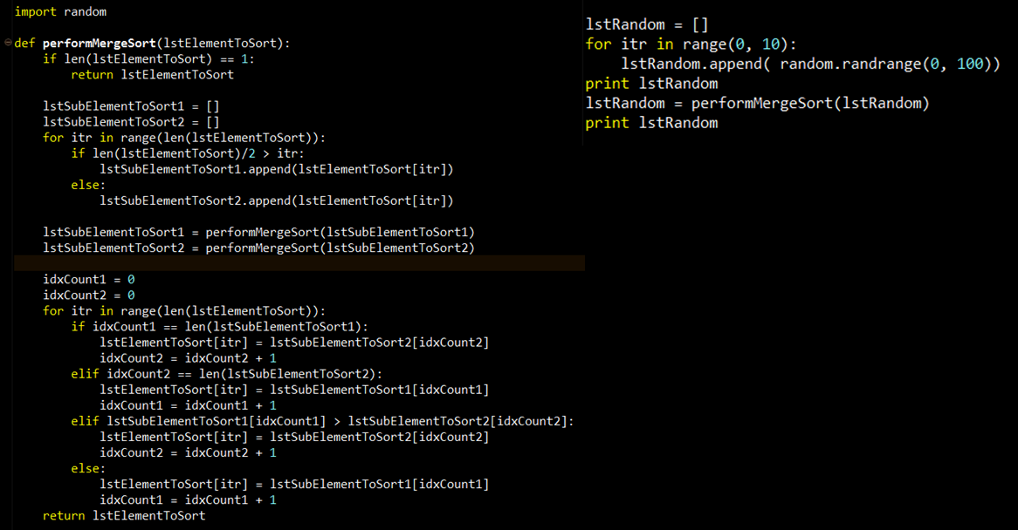
Implementation Example: Merge Sort
Execution Code
Decomposition
Code execution timing!
Before Recursion
= Before Branching out
After Recursion
= After Branching out
Recursion
Aggregation
Notes:
This is the code that implemented the merge sort we’ve discussed in Python.
It is imperative for you to implement the code here in an actually executable environment.
Let me briefly explain to you how to implement the merge sort.
For now, let’s locate where the recursion takes place.
First, it calls performMergeSort and receives the target list for sorting in the form of parameters.
The function is called as the parameters, which are in reduced size within the function.
As the entered list is split in half, this means there are two function calls.
However, their sizes must be decreased.
As in lstSubElementToSort1 and lstSubElementToSort2, they should take a reduced form in terms of size.
Because of that, we have to create a decomposed list.
This very process is what handles this task.
Here, you will find a setting to generate two empty lists. Half of the received list should be stored in the 1st list. The rest will be appended to another list.
This process will eventually generate two decomposed lists.
Now, we get the result of performMergeSort.
The names of these variables are the same, and their values are saved.
That’s because the function in which the parameter is assigned will be overwritten by the return values.
The return values will form sorted sub lists
This is the process of combining two return values.
This part here is an aggregation part.
First, we will utilize two indexes.
If the length becomes identical with idxCount, it will leave no room for comparison. Instead, it will use the data from a place that allows comparison.
If they both have those values, their values will be compared to use whatever the smaller value is.
In the end, it will return the combined lstElementSort to complete performMergeSort.
After conducting the decomposition of merge sort, a recursion will take place. Then, the returned values will be applied to an aggregation process.
Where is the escape routine here?
It is right here at the starting point.
If you see this “if” sentence, it means to return if the length is a single.
That means that it is not dividable.

Slide 10
Problems in Recursions of Fibonacci Sequence
Problems in recursions
Excessive function calls
Calling functions again and again
Even though the function is executed before with the same parameters
For instance, Fibonacci(4)
Has two repeated calls of F(0)
Has three repeated calls of F(1)
Has two repeated calls of F(2)
These are unnecessarily taking time and space
How to solve this problem?
F(4)
F(3)
F(2)
F(2)
F(1)
F(1)
F(1)
F(0)
F(0)
Notes:
That means that it is not dividable.
Using recursion sometimes has problems.
One such problem is that it generates too many function calls.
As function calls keep on occurring, it repeatedly calls the same parameters by calling the previously called functions.
We can see this for ourselves in the Fibonacci example.
If F(4) is called, there are two F(2)s while F(1) is repeated three times.
Also, F(0) is repeated with the same parameters twice.
If a function with identical parameters is called, it will always lead to the same values.
Do we have to duplicate the same task over and over again, just to get the same values?
No, we don’t.
If we are to calculate F(100), it will be uncalculatable.
It will unnecessarily exhaust too much time and memory space.
What can we do to remove too many recursions?
That’s when we need dynamic programming to reduce the overlapping function calls.
The gist of dynamic programming lies in eliminating overlapping function calls. It does this by storing the outcomes of the called functions

Slide 11
Dynamic Programming
Notes:
Let’s figure out how to eliminate unnecessary function calls with dynamic programing.

Slide 12
Dynamic Programming
Dynamic programming:
A general algorithm design technique for solving problems defined by or formulated as recurrences with overlapping sub-instances
In this context, Programming == Planning
Main storyline
Setting up a recurrence
Relating a solution of a larger instance to solutions of some smaller instances
Solve small instances once
Record solutions in a table
Extract a solution of a larger instance from the table
F(4)
F(3)
F(2)
F(2)
F(1)
F(1)
F(1)
F(0)
F(0)
Instance | Solution
F(0) | 0
F(1) | 1
F(2) | 1
F(3) | 2
F(4) | ?
Notes:
Dynamic programming can be defined this way.
It is not a specific algorithm like a merge sort algorithm. Rather, it is a general problem-solving method that encompasses recurrences with overlapping sub-instance.
In some context, programming can be viewed as planning.
The Industrial engineering department may regard dynamic programming as a form of dynamic scheduling or dynamic planning.
It can be applied to cases when sub-instances heavily overlap.
For example, the values calculated to find out the result of F(4) are overlapped like this. Dynamic programing provides a solution for this type of problems,
We will see how dynamic programming is employed as a concept.
It seems like it makes a large recurrence structure smaller, but it actually works the other way around.
First, let’s simply solve this small instance as a start.
In solving F(4), we would start figuring out small instances related to the larger problem.
It starts with F(0) and F(1). This is based on that expectation that solving F(0) and F(1) first would lead to us solving F(4).
F(0) and F(1) will instantly obtain 0 and 1 from the escape routine.
To get the values, we had to calculate them each time we received them in the local variable. Now, we don’t need to do this.
Now, these values will be stored.
The F value for n will be recorded in table form. The results from ones with a smaller size are used to calculate the values of the larger ones.
As the values of F(0) and F(1) are recorded in calculating F(2), we can compute F(2) right away.
Rather than tackling a problem with a larger size directly, it approaches the larger problem by starting from the smaller problems.

Slide 13
Memoization
Key technique of dynamic programming
Simply put
Storing the results of previous function calls to reuse the results again in the future
More philosophical sense
Bottom-up approach for problem-solving
Recursion: Top-down of divide and conquer
Dynamic programming: Bottom-up of storing and building
Stackframe
Memoization
F(4)
Recursion
Instance | Solution
F(0) | 0
F(1) | 1
F(2) | 1
F(3) | 2
F(4) | 3
F(3)
F(2)
Dynamic Programming
n
2
R.A
F(2)
F(1)
n
3
F(1)
F(1)
F(0)
R.A
n
4
F(0)
R.A
Notes:
Now, we will talk a look at memoization.
Memoization is different from memorization.
It pertains to the core of dynamic programming that avoids overlapping small instances. It’s about recording results.
We need something to record the outcomes to reuse the existing function calls and their results.
I mentioned that we would make a table, which is called a memoization table.
In dynamic programming, the space allocated for storing the previous results is called a memoization table.
Two contrary philosophies underpin the memoization and stack frame to enable a recursion.
One is a bottom-up approach
The memoization table is based on the bottom-up approach, meaning ascending from the bottom to the top.
It involves the process of calculating from the bottom, F(0) and F(1), to F(4).
This is the memoization table of dynamic programming.
Although it is not clear when F(4) would be accomplished, it keeps on recording the past calculation results. It does this, believing that it will someday reach the larger problem F(4) by starting with solving the smaller problems. That’s the essence of memoization.
Conversely, a recursion is based on a top-down approach.
In a top-down approach, it is necessary to solve F(3) and F(2) to solve F(4). So, F(3) is pushed and F(2) is also pushed to solve F(2).
A recursion tackles the final target first. It calls sub-instances for the purpose.
We’ve seen that the recursion approach is the opposite of dynamic programming
Recursion uses a top-down approach and a stack fame, while memorization uses a bottom-up approach.
When there are countless overlapping sub-instances found in a recursion, we need to solve the problem with dynamic programming. This is the best way to remove repetitive identical function calls.
The memoization table is what we can use to store the results of function calls in this process.

Slide 14
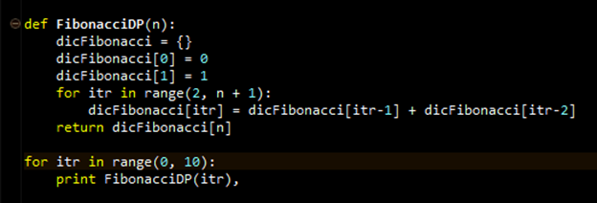
Implementation Example: Fibonacci Sequence in DP
Setting up a memoization table
Building up a bigger solutions
Execution Part
Use a dictionary collection variable type for memoization
Memoization
Storing a fibonacci number for a particular index
Now,
We have a new space requirement, the dictionary or the table, of O(N)
We have reduced execution time from O(2^{n}) to O(N)
Notes:
Thus far, we’ve reviewed the concepts related to techniques: dynamic programming and memoization.
Now it’s time to exercise the concepts by applying them to the Fibonacci sequence.
The last time we used the Fibonacci sequence, we solved the problem with a recursion, which called a function within a function.
By employing dynamic programming, however, there is nothing we can use to directly to call a function within the function.
This is a memoization table, a space that may accumulate any solutions from small-scale problems.
In other words, it is a dictionary.
A dictionary assumes a form to store key-value pairs.
It stores 0 in a key named 0 and 1 in a key called 1.
If we were to write down keys and values for the Fibonacci sequence, the default and current condition would stores0 in the key 0 and 1 in the key1.
Let’s consider about a situation with Fibonacci(4).
As n equals 4, given that 0 and 1 are in there by default, the iteration begins with 2.
At the end, it will be 5 as it is “n + 1”, and the iteration may go on until 4, or less than 5.
The list obtained from the range is [2, 3, 4].
The first itr in this situation will be 2.
So, we have 2 entered here.
Given that itr is 2, as the values of itr-2 = 0 and itr-1 = 1 are added, it will place value 1.
Here, you will find a “for” loop running around one sentence.
It will make itr to be 3 for the next iteration.
Thus, it will be 3 as well as itr-2 = 1 and itr-1 = 2.
It indicates that the values 2 and 1 should be combined so that it will be 2 with the key 3.
Finally, itr becomes 4.
It results in itr-2 = 2 and itr-1 = 3
Consequently, the key named 4 will get the value 3.
Finally, it will return dicFibonacci[n].
As n = 4, dicFibonacci will return 3, the value for the key 4.
Unlike the previous case, dynamic programming allows us to complete the process with a single “for” loop.
Instead, it will pile up from smaller values in the memoization table.
Applying the dictionary collection, we were able to create the memoization table for dynamic programming with no trouble.
We will cover the dictionary collection about 3 weeks later.
This is a Big-o-notation, a value to represent certain limitation.
The table will have a total of N rows.
So, it is O(N).
In a recursion, it kept on dividing into branches as in the tree structure here.
In this way, we already have 2³-1 with just three layers.
It’s uncountable.
Although this recursion requires innumerous function calls, we can conduct the same operation with just N memoizations.

Slide 15
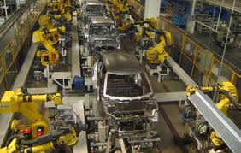
Assembly Line Scheduling
Assembly Line 1
station S_{1,1}
station S_{1,2}
station S_{1,3}
station S_{1,4}
station S_{1,5}
station S_{1,6}
7
9
3
4
8
4
2
1
3
4
3
2
3
Production Start
Production End
2
1
2
2
1
4
2
8
5
6
4
5
7
station S_{2,1}
station S_{2,2}
station S_{2,3}
station S_{2,4}
station S_{2,5}
station S_{2,6}
Assembly Line 2
Goal: Computing the fastest production route
Notes:
Now let’s consider the way to apply it not to the Fibonacci sequence, but something more realistic.
Dynamic programming is indeed very useful in reality.
One of the most important examples is a production process.
This is an automobile left unfinished.
This vehicle gets assembled piece by piece throughout the production process.
If we assume that the automobile should go through six robots in the production line, two lines could be in operation.
It would be ideal to carry out the production process according to a schedule, but isn’t always attainable.
This is because various unexpected events might occur. For example, there may be a lack of parts or a malfunction with the robotic machinery.
So, if we thinking of one whole process as a station, each station may have different duration.
Then, the difference in time for the stations allows us to figure out how to minimize the total duration by sending newly introduced products into available lines.
This is the part at which the production starts, and that is where production ends.
The number here represents the time consumed.
It signifies the duration of time for transferring goods from one process to another or for the completion of a process.
Here, it says it takes 4, 8, 5, 6, 4, 5, 7, and finally 2 seconds.
This line requires 2, 7, 9, 3, 4, 8, 4, and 3 seconds.
With the lines set parallel to each other, each line has six stations.
If this station takes a longer time because it is bottlenecked, it is possible to route some of the work out to this part.
That’s why one way is to continue the next process: moving the work into the line next to the original one.
This shows the arrow from the side, and the number is the time consumed to transfer.
Suppose that it won’t take long to move from one line to the other.
From the beginning of the assembly, we can apply dynamic programing to minimize inefficiency. We can reduce the time required for the most basic goods to be moved to a station and for continuing the assembly work by transferring work to the next line, as well as the time to produce the goods after the final process.
Dynamic programming can offer a solution for this kind of production line plan or schedule.
Let’s find out how to apply dynamic programming to this type of problem.

Slide 16
Process of Assembly Line Scheduling
station S_{1,1}
station S_{1,2}
station S_{1,3}
station S_{1,4}
station S_{1,5}
station S_{1,6}
7
9
3
4
8
4
2
1
3
4
3
2
3
Production Start
Production End
2
1
2
2
1
4
2
8
5
6
4
5
7
station S_{2,1}
station S_{2,2}
station S_{2,3}
station S_{2,4}
station S_{2,5}
station S_{2,6}
Assembly Line 2
Time | 1 | 2 | 3 | 4 | 5 | 6
L1 | 9
L2 | 12
Trace | 1 | 2 | 3 | 4 | 5 | 6
L1 | S
L2 | S
Notes:
We’ve learned that the basic mechanism of dynamic program is a bottom-up approach.
Simply put, it breaks down a larger problem into smaller chunks.
Thus, we’ve got to start from the easiest problems rather than attempting to chart the entire route right away.
Let’s take a stab at when the first station would be completed, whichever line the goods take.
Our goal is to solve the final problem by building up from the smaller problems, step by step.
Let’s examine how to store the processes of solving small problems at a higher level.
In this regard, we will plan out the structure of the memoization table like this.
First, we would call it “travel time.”
I’ll write down the shortest time to arrive at the station of each line as the travel time.
No matter what method we adopt, the 1st station of the 1st line takes at least 9 seconds.
The minimum time required for the 1st station of the 2nd line is 12 seconds.
Thus, this is the minimum travel time, which could serve as a basic unit to be accumulated and to eventually determine which line would offer the shortest process times.
After that, we do not just write down the minimum travel time. We also write what is called a retrace table that shows which path has been taken to get here.
Later, I will show you how to recognize which path has been taken to get here with this retrace table.
It’s no problem up until the 1st station.
In this scenario, there is no backward direction. We can only move in a single direction.
It took 2 and 7 seconds for the 1st line, totaling 9 seconds, while the 2nd line took 4 and 8 seconds, totaling 12 seconds.
Similarly, as we only have one departure spot or “start point,” we can save the prior locations of the two lines before arriving at here as the “start point.”
It makes it clear that that it unconditionally takes at least 9 seconds or 12 seconds from here to there.
Now that we’ve figured out this much in this small problem, we can work on this problem at a larger scale.

Slide 17
Process of Assembly Line Scheduling
station S_{1,1}
station S_{1,2}
station S_{1,3}
station S_{1,4}
station S_{1,5}
station S_{1,6}
7
9
3
4
8
4
2
1
3
4
3
2
3
Production Start
Production End
2
1
2
2
1
4
2
8
5
6
4
5
7
station S_{2,1}
station S_{2,2}
station S_{2,3}
station S_{2,4}
station S_{2,5}
station S_{2,6}
Assembly Line 2
Time | 1 | 2 | 3 | 4 | 5 | 6
L1 | 9 | 18
L2 | 12 | 16
Trace | 1 | 2 | 3 | 4 | 5 | 6
L1 | S | 1
L2 | S | 1
Notes:
Up to this point, it takes 9 seconds with no exceptions.
That’s the minimum time.
In this scenario, let’s find out how long it takes to get to the 2nd station.
Now the problem gets more challenging.
There are a total of two ways to get to the station2 of the 1st line.
One is to pass through the line, staying in the line where it was originally located, and the other is to use the line next to the original.
If we choose the 1st method, it took a minimum of 9 seconds to arrive at the 1st station and another 9 seconds were required to handle here. This is a total of 18 seconds.
As for the 2nd method, it took 12 seconds to reach the 1st station in the 2nd line, and 2 seconds to move to another station, and 9 seconds in this station, totaling 23 seconds.
So, the fastest way to get to this location is to select the 1st method.
It takes 18 seconds.
Otherwise, we may choose to trace up from the bottom. However, this won’t be a good alternative since it would take 23 seconds.
Next, let’s consider the 2nd station of the line down below.
In this case, there are two ways available: one is to proceed with the 2nd line as it is, and then select the 1st line.
If we think about the way to get down from the top, we should add 9 seconds, 2 seconds of travel time, and an additional 5 seconds for processing. This would be a total of 16 seconds.
If we calculate the 2nd line from the place where it is located, it will take a total of 17 seconds: that’s 8 seconds to get to the 1st station and 5 seconds for processing.
The top-down way takes less time.
In this case, it will take 16 seconds, which is shorter than choosing the original line, 17 seconds.
Considering all the available arrows, the time consumed to get to this point is 18 seconds. To get here, it’s 16 seconds.
If we use a recursion to solve this problem, it would take quite a long time. That’s because it involves multiple calculations of the travel times required to reach prior to this point.
Employing dynamic programming, however, we have the advantage of being able to augment the problem without having to repeat the calculations of the previous stages.
To calculate the travel time taken up to this point, we can widen the boundary of the problem with additions for two times.
By repeating this process, we can eventually solve the final question.
Now that I’ve extensively explained minimum travel time to you, you can figure out the rest.
However, this does not hold true for a retrace table.
I formally stated that it originates from a start point.
S_1, 2 should have passed though what’s above stemming from S_1, 1.
That means a better alternative to it was the line of the previous time.
It shows that it takes the shortest time to receive a good from the first line of the station just before.
If it was a better option to receive a goods from the 2nd line below, we may need to write down 2. However, it was better to receive it from the 1st line, so we write down 1 instead of 2.
Then what’s the fundamental source of the problem?
Here, you see the two optimized routes that take 9 and 12 seconds. The difference between 9 and 12 will determine the location where god should be received.
Therefore, the retrace table helps us determine a less time-consuming route and calculate the minimum travel time based on it.

Slide 18
Process of Assembly Line Scheduling
station S_{1,1}
station S_{1,2}
station S_{1,3}
station S_{1,4}
station S_{1,5}
station S_{1,6}
7
9
3
4
8
4
2
1
3
4
3
2
3
Production Start
Production End
2
1
2
2
1
4
2
8
5
6
4
5
7
station S_{2,1}
station S_{2,2}
station S_{2,3}
station S_{2,4}
station S_{2,5}
station S_{2,6}
Assembly Line 2
Time | 1 | 2 | 3 | 4 | 5 | 6
L1 | 9 | 18 | 20
L2 | 12 | 16 | 22
Trace | 1 | 2 | 3 | 4 | 5 | 6
L1 | S | 1 | 2
L2 | S | 1 | 2
Notes:
Let me recap, for those who still have some problem understanding it.
From this point on, we’ve increased the size of the problem.
Here, the minimum travel time was 2 and 7 seconds, thus becoming 9 seconds. It’s now 12 seconds up to this point.
Consider this: we can get 18 by adding 9 to 9 and 23 by adding 12, 2, and 9.
12 here is guaranteed to be the minimum travel time, and it’s written in the memoization table.
18 becomes the minimum travel time as it is faster than 23.
Here we had two options, but as the 1st line was faster, we need to write down 1.
9 is added to 2 and 5 to make 16, and 12 is added to 5 to be 17.
We’ve learned in the previous slide that considering travel time to transfer to another line, it was faster to use the 1st line. It was better to obtain a good not straight from the 2nd line but from the 1st line. That’s why we write down 1.
There is no other alternative travel time, but 18 and 16 also satisfy the condition for the minimum travel time.
Now, let’s advance the problem one step further.
It’s the same method we use for identical problems.
Again, there are two ways to arrive at the 3rd station of the 1st line: right from the 1st line, it will be 18 + 3 = 21. From the 2nd line, it will be 16 + 1 + 3 = 20.
Therefore, the minimum travel time is found in the 2nd line, which is 20.
As it took less time to receive a good from the 2nd line than the 1st one, we would write 2 instead.
This problem is based on varying process times of different lines.
Also, there are two available ways to reach the 3rd station in the 2nd line.
If we choose the 1st line, it will take 27 hours (time) as it is 18 + 3 + 6 = 27.
The 2nd line allows us to reduce travel time so that it will be 16 + 6 = 22 hours.
As it is advantageous to get the product from the 2nd line for the 3rd station in the 2nd line, we write down 2 in the retrace table.
We’ve figured out the larger-scale problem by applying the same method from the previous case.
It’s possible to solve the augmenting problems till the end of the process by applying the same method.

Slide 19
Process of Assembly Line Scheduling
station S_{1,1}
station S_{1,2}
station S_{1,3}
station S_{1,4}
station S_{1,5}
station S_{1,6}
7
9
3
4
8
4
2
1
3
4
3
2
3
Production Start
Production End
2
1
2
2
1
4
2
8
5
6
4
5
7
station S_{2,1}
station S_{2,2}
station S_{2,3}
station S_{2,4}
station S_{2,5}
station S_{2,6}
Assembly Line 2
Time | 1 | 2 | 3 | 4 | 5 | 6
L1 | 9 | 18 | 20 | 24 | 32 | 35
L2 | 12 | 16 | 22 | 25 | 30 | 37
Trace | 1 | 2 | 3 | 4 | 5 | 6
L1 | S | 1 | 2 | 1 | 1 | 2
L2 | S | 1 | 2 | 1 | 2 | 2
Notes:
We’ve grown the scale of this problem to this point before, and the results of the growing problems are as below.
In conclusion, it takes 35 seconds to reach station_1, 6 and 37 to get to station_2, 6.
If so, which line would be the best choice?
Considering the time to produce the final output, the 1st line is 35 + 3 and the 2nd line is 37 + 2, so it takes 39. Therefore, this one is the best option.
Now we’ve learned that the product reaches here through the minimum travel time, or 38.
Thus, it is a retrace table that we utilize to generate the travel time of 38.
It is said that receiving a goods from the station_1 or 6 was the better choice in the last stage.
In the retrace table, station_1,6 is marked by the number 2. This implies that the 2nd line provides a better option.
That’s why we could say the it would have been better to get the goods from this direction.
In case of station_2, 5, it was proved that collecting the goods right away from the 2nd line still constituted the best option.
In case of the station_2, 4, the best option was the first line, so we use station_1,3.
It is ideal for the station_1,3 to pick up the goods from the 2nd line.
And so, the best choice for the station_2,2 was skipping one station, the station_1,3, the first line of the just prior station.
So, station_1,1 acquired the goods from the start.
Now let’s draw a line to delineate the path of travel.
If we travel this way, it will take total 38 hours.
To sum them up, it will be: 2 + 7 + 2 + 5 + 1 + 3 + 1+ 4+ 5 + 1 + 4 + 3 = 18
Therefore, we can compute the minimum travel time with memoization.
The retrace table could be used for making a production route by storing the previous choices.
These two data structures allow us to schedule the conveyor belts for moving goods.

Slide 20
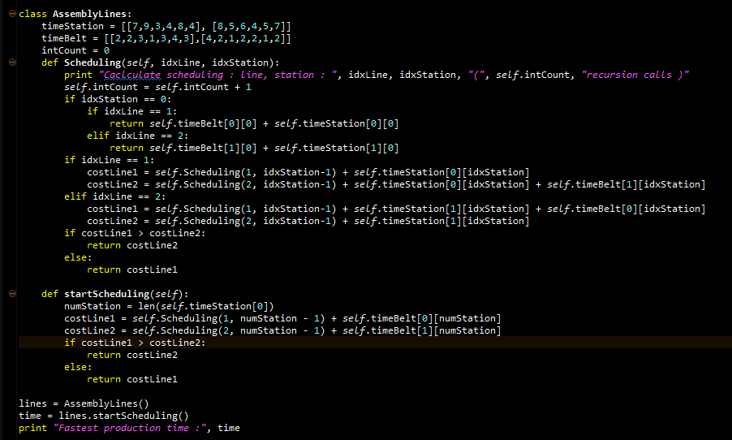
Implementation Example: Assembly Line Scheduling in Recursion
Setting up recursion calls
Notes:
This week, we’ve covered recursion and dynamic programming.
The previous problem could either be solved with a recursion or dynamic programing.
I’ve constructed two codes.
I encourage you to build and implement your own code at home.
To improve your skill, you need firsthand practice.
To put it simply, there is a function called Scheduling.
Basically, a recursion occurs in this function.
Here we should check two things, and one is an escape routine.
This is an escape routine I built.
Then we should search for a part that has a self-calling recursive function call.
That makes a part called scheduling here.
Although they are all identical, it should take the shape of the diminishing problems.
This part features a decreasing scheduling problem.
For instance, it gets smaller with idxStation.
As a result, recursive calls take place.
This would help you to grasp the basic recursion structure.
I recommend you to implement it.

Slide 21
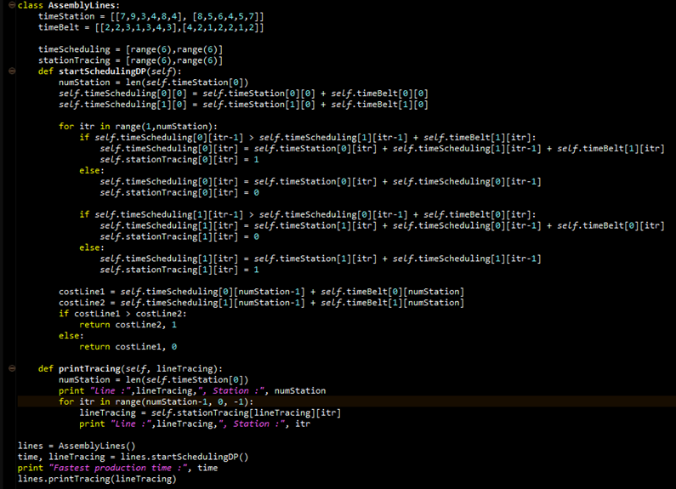
Implementation Example: Assembly Line Scheduling in DP
Setting up a memoization table
Building up a bigger solutions
Notes:
This is a solution using dynamic programming.
It may appear to have more complicated code in dynamic programing, but it’s actually simpler in terms of implementation.
Dynamic programming requires a retrace table and memoization table.
Now let’s see how it stores these tables.
Here you will see the definitions for timeScheduling and stationTracing
Using the definition, we can trace it.
Then, we need to enlarge the problem into a larger version step by step.
We employ a “for” loop to grow the problem.
Through a for loop, itr is carried out from 1 to numStaion.
For a default setting, this part is used to set up the default state.
Thus, it will implement the initialization of the memoization table here and be the definition of the table.
After that, we’ve generated the process of increasing the problem size with dynamic programming.
I also urge you to implement it, and see what you find.

Slide 22
Further Readings
Introduction to Algorithms by Cormen et al.
pp. 62-76, 323-356

